Slide 1
CSCI 3302 Introduction to Robotics
Alessandro Roncone
aroncone@colorado.edu

Slide 2
Lab 5 Mapping and Planning

Slide 3
Recap
Lab 2 – Forward Kinematics [wheel velocities → robot x, y, θ]
Lab 3 – Inverse Kinematics + Feedback Control
Lab 4 – Mapping
Lab 5 [today – April 7] -- Put it all together

Slide 4

Today: Odometry, Mapping and Inverse Kinematics
Y
???
???
rotation
???
X
How can I put it all together?
Notes:
Photoresistor decreases resistance with increasing incident light intensity

Slide 5
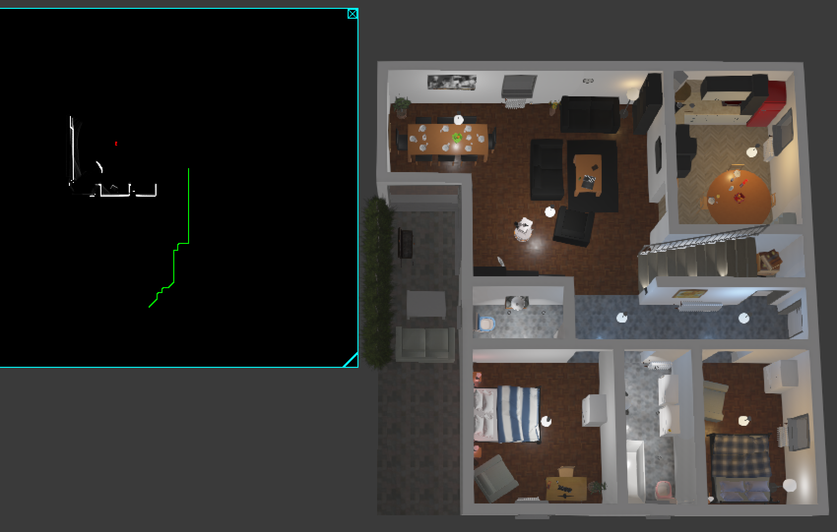
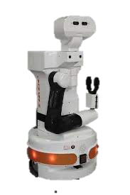
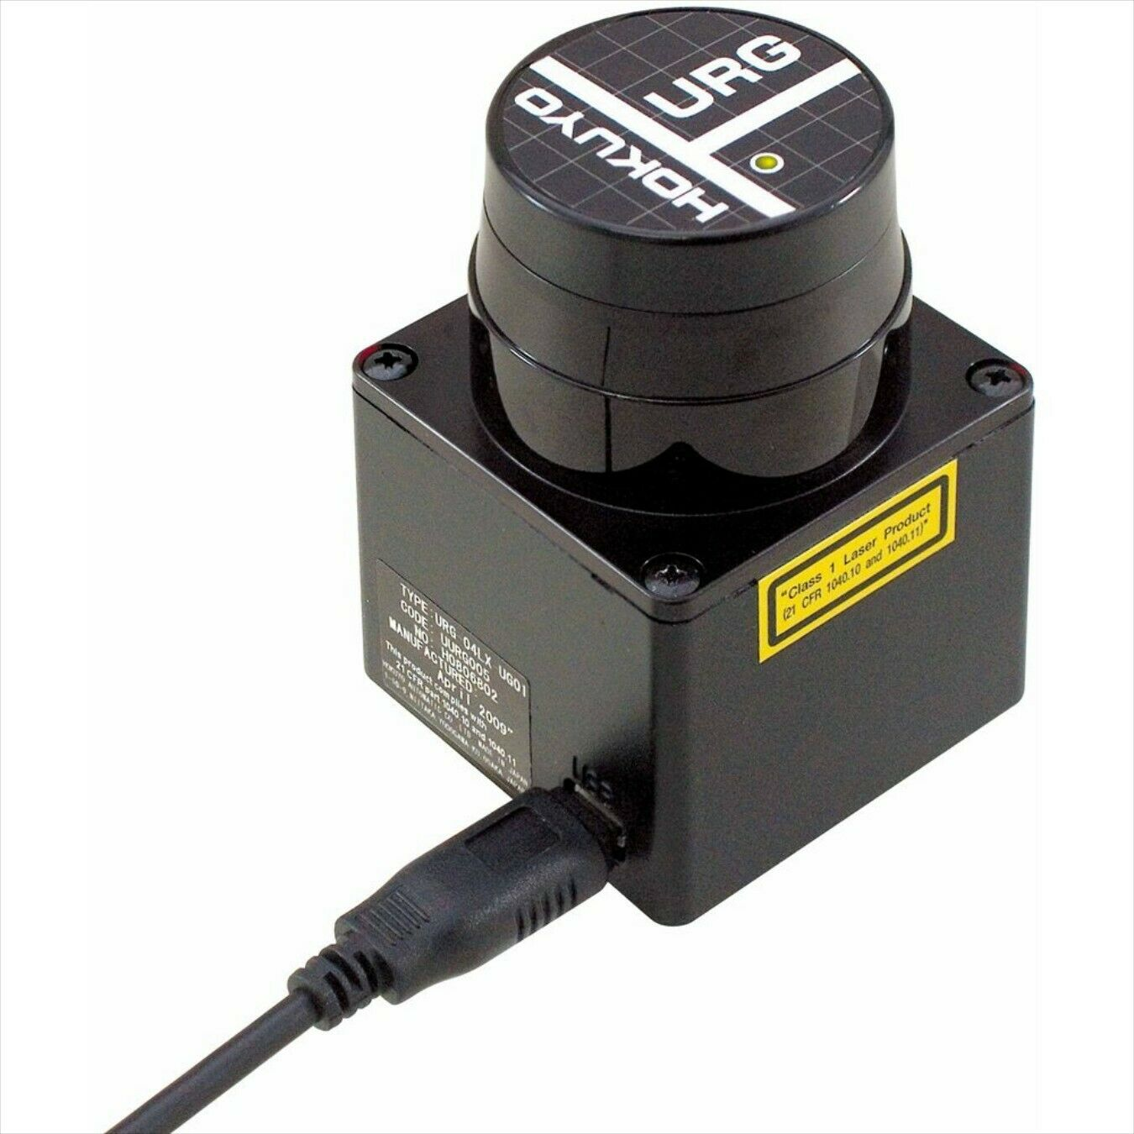
Lab Setup
TIAGo
240° range
First 83 + last 83 rays thrown away due to hardware design
Notes:
Photoresistor decreases resistance with increasing incident light intensity

Slide 6
What problems did you run into when using the laser sensor map?

Slide 7
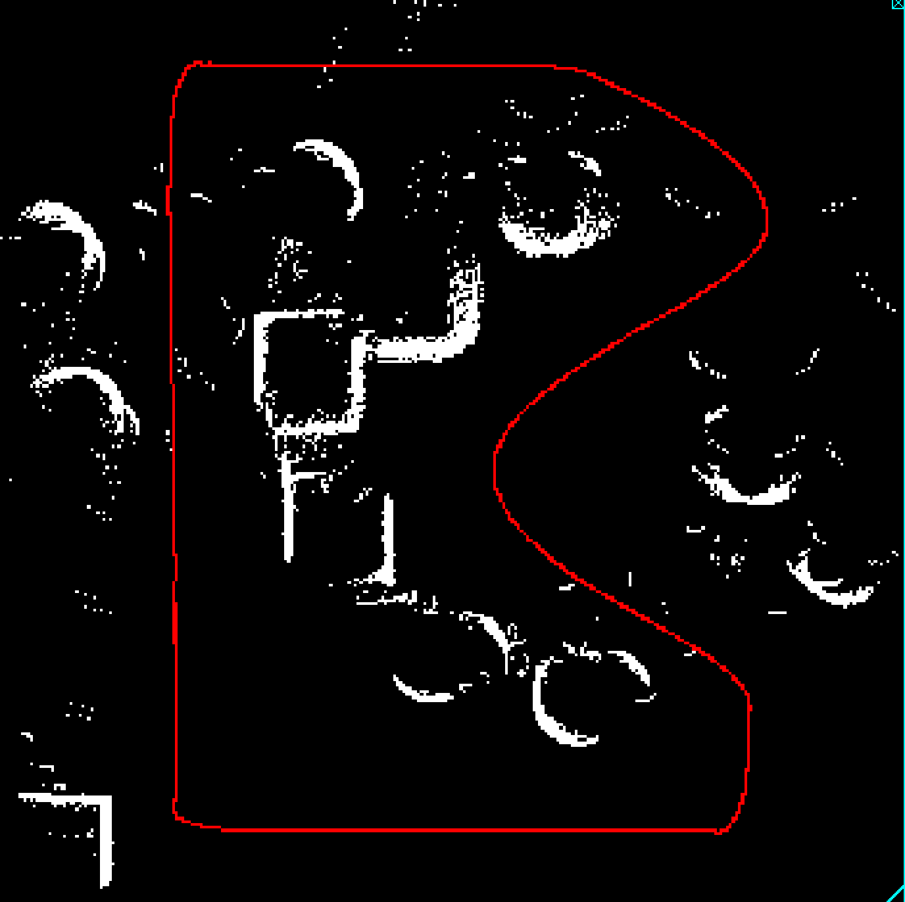
Noise. Obstacles everywhere!
Sources: reflections, artifacts from robot braking, etc.
Turn measurements (true/false) into a probability
Grid map stores the probability of a cell being an obstacle or not
Every positive measurement increases the probability
Use a threshold to decide

Slide 8
What problems did you run into when programming a path-following system?

Slide 9
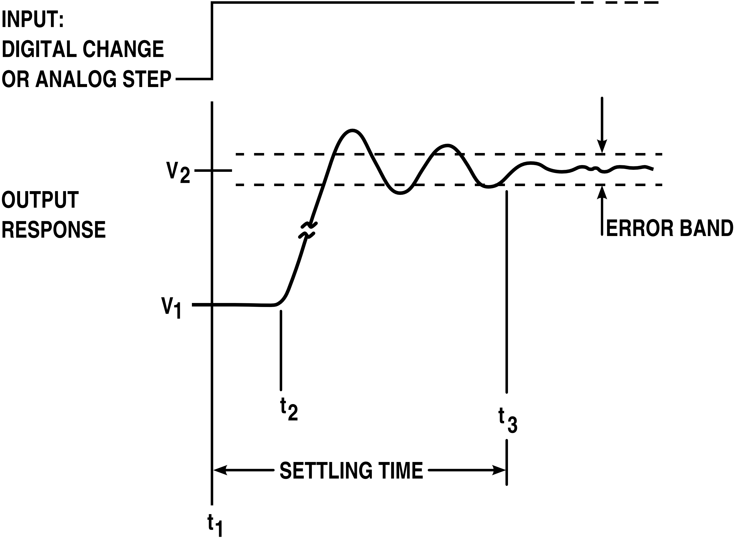
Control issues
Find the right trade-offs in your gains
Minimize settling time
Minimize tracking error
Learn to live with your controller not being perfect and stay away from obstacles

Slide 10
What parameter do you think will affect planning time the most?

Slide 11

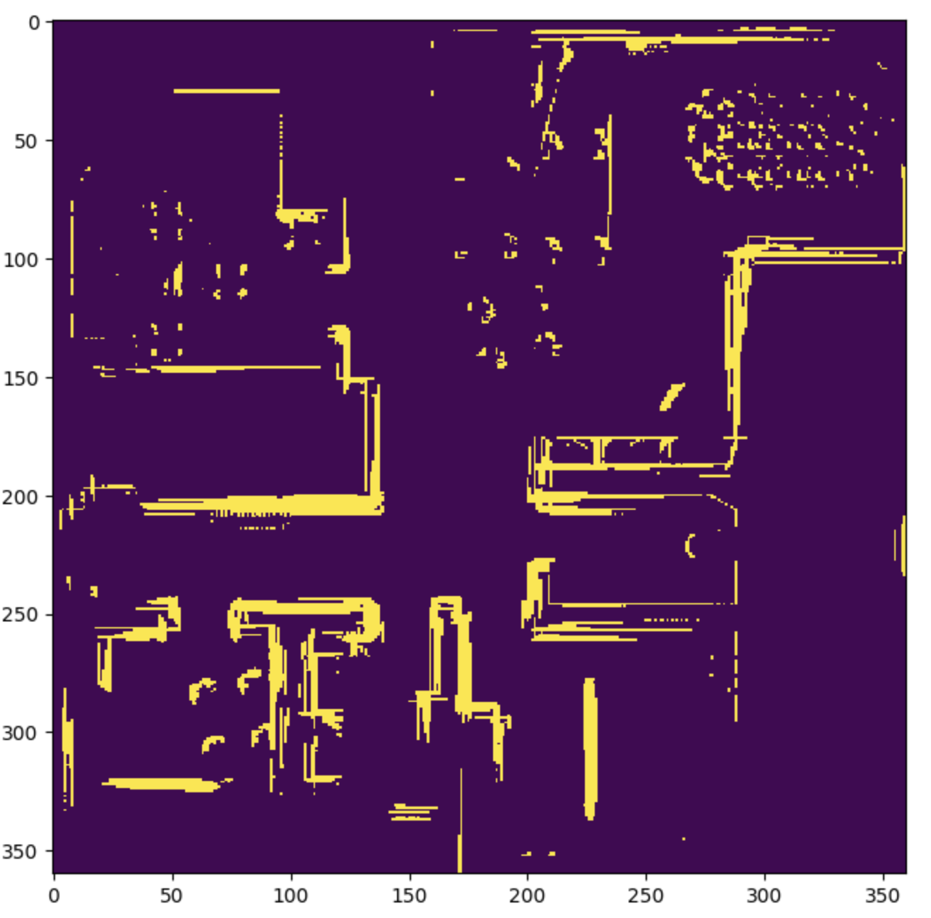
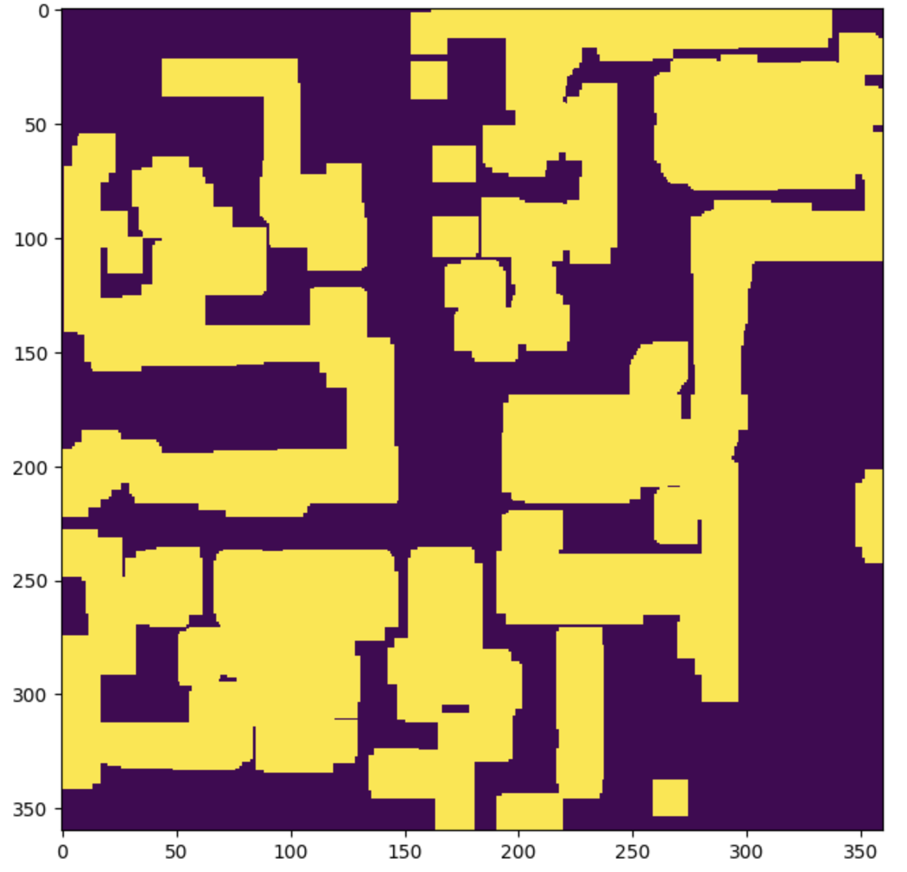
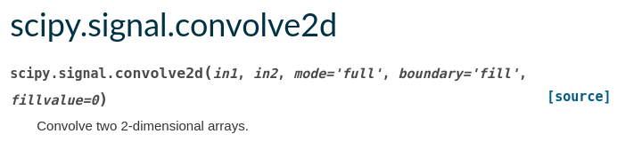
C-SPACE

Slide 12

Path Planning
Dijkstra's
A*

Slide 13
3 modes in provided code skeleton
Manual mode for mapping
Use keyboard control to drive around
Save generated map to map.npy
Planner mode for path generation
Implement + test planning algorithm on toy map (to parallelize teamwork)
Create configuration space. Visualize.
Plan path (using A*[highly recommended] or Dijkstra's) in config space. Save planned path to .npy file.
Autonomous mode for path following
Load path from .npy file. Visualize.
Execute using feedback control

Slide 14
This lab is worth 150 points!
FAQs:
What’s due at the end of today?
Nothing, this is a 2.5-week lab. Due Friday 04/07 at 11:59pm.
What do I turn in?
ONE person needs to turn in the lab report and code per group.
We’re done! Can we leave?
Yep. Lab is meant to provide an interactive problem-solving time. If you complete the work early, you are free to go!

Slide 15
Questions?

